Slide 1

Dimensionality Reduction in Machine Learning
INDABAX MALAWI 2022
October 14, 2022
By Aurelie Jodelle Kemme

Slide 2
What is dimensionality reduction?

Slide 3
What is Machine Learning?

Slide 4
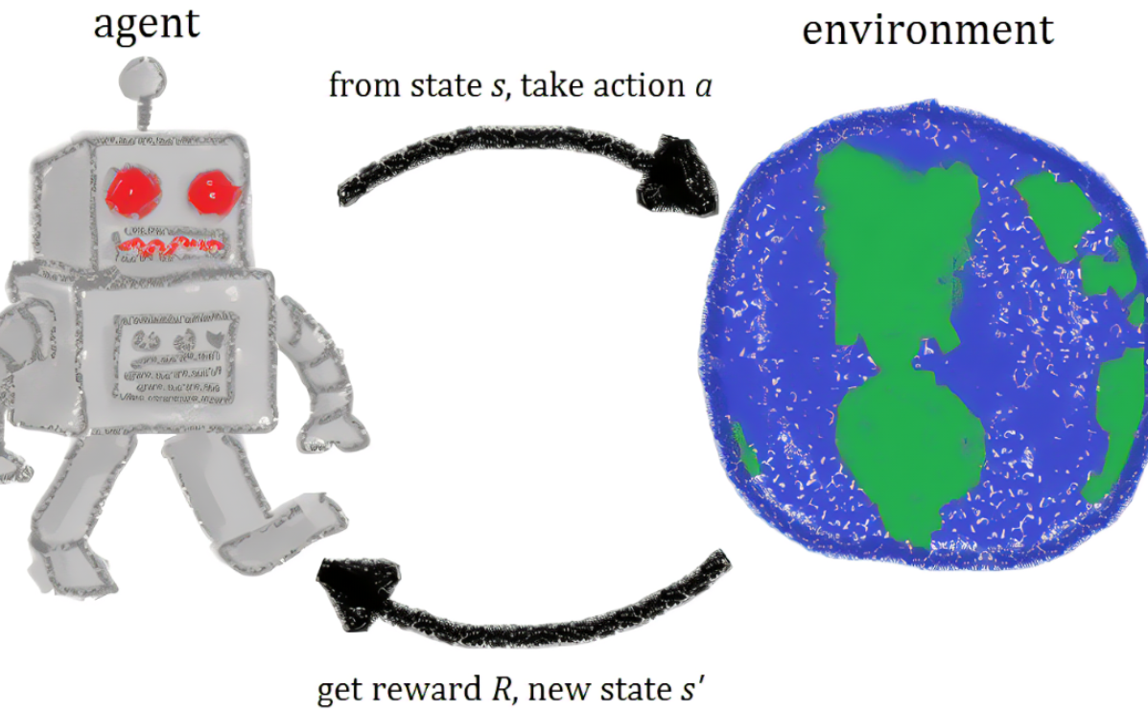
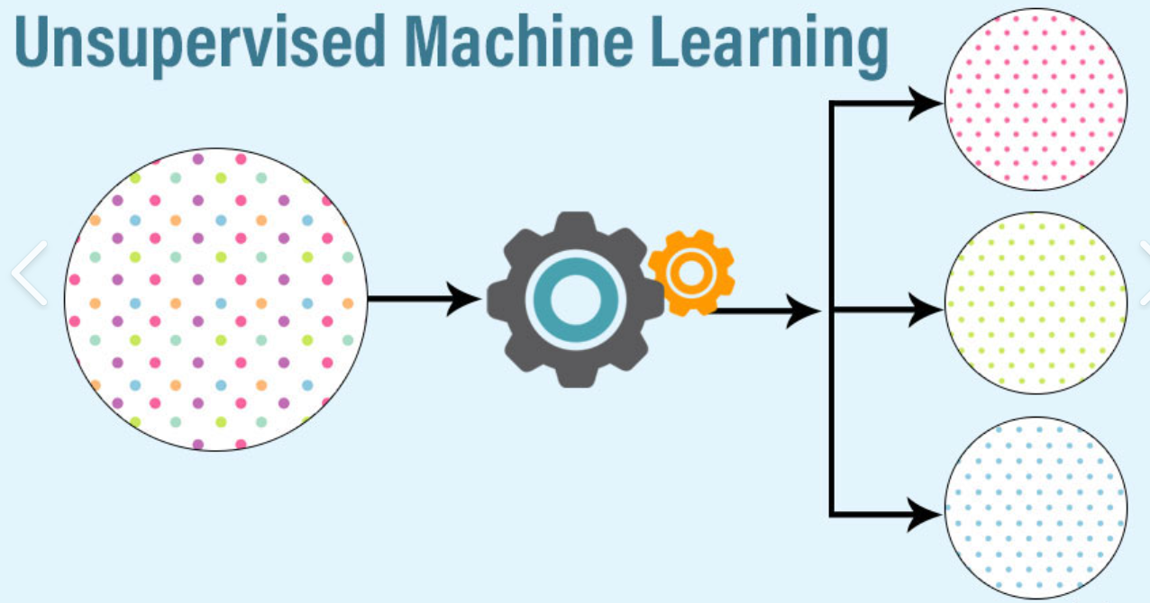
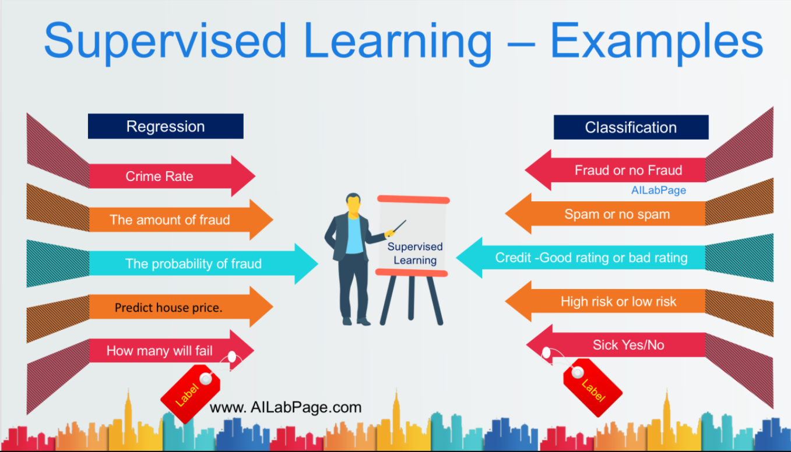
Some Machine Learning
Techniques
Supervised Learning
Regression
Classification
Unsupervised Learning
Clustering
Dimensionality Reduction
Reinforcement Learning

Slide 5
Why dimensionality reduction?

Slide 6
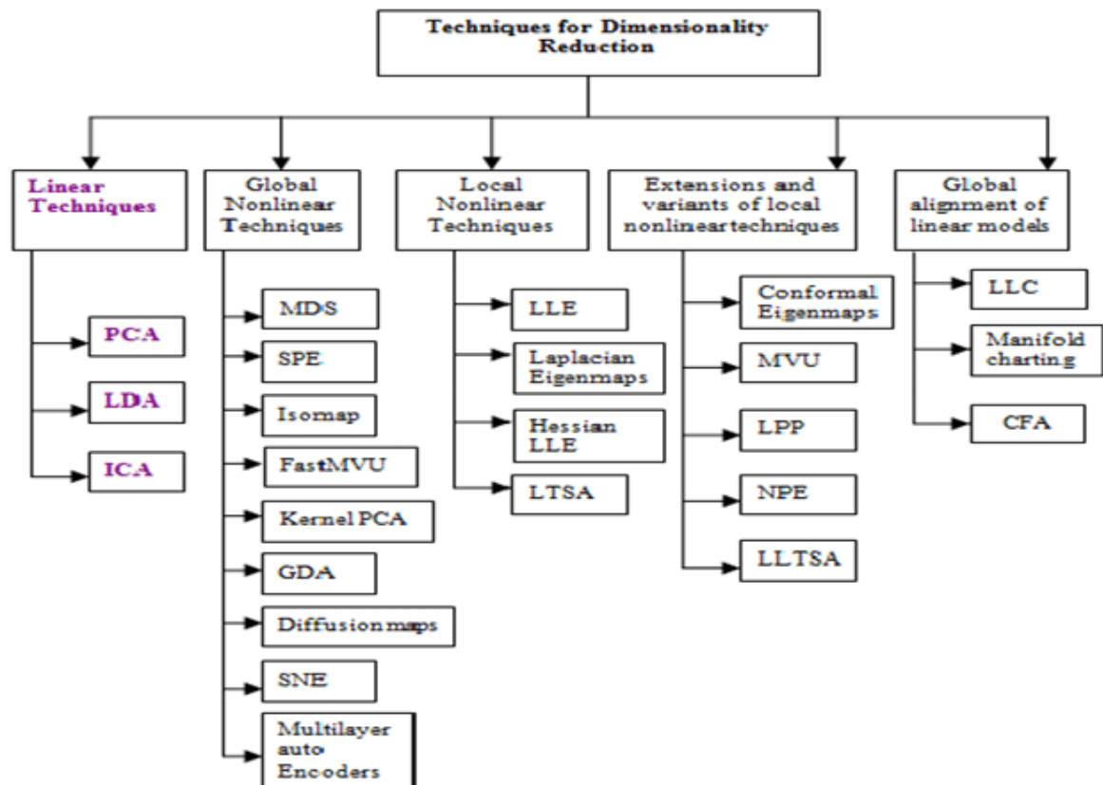
Methods for
Dimensionality Reduction

Slide 7
PCA
Request to standardize the data
Need linear dependency
Less interpretable
Failed with weak correlation
May cause some loss of information
Remove correlated features
Improve visualization
sklearn.preprocessing import StandardScaler
sklearn.decomposition import PCA

Slide 8
LLE
Challenges
How to select the KNN
Define the reconstruction cost,
How to express a point as a linear combination of its neighbors
Compute KNN associated with each data point;
Compute matrix of weights whose entries minimize the reconstruction error;
Compute the objective function that minimizes the error.

Slide 9

Thank you !
jkemme@quantumleapafrica.org
jodelle.kemme@aims-cameroon.org

